Slide 1

Process Deadlocks

Slide 2
Process Deadlocks (6 hrs.)
+Introduction
+Deadlock is a situation where a set of processes are blocked because each process is holding a resource and waiting for another resource acquired by some other process.
+A Deadlock is a situation where each of the computer process waits for a resource which is being assigned to some another process. In this situation, none of the process gets executed since the resource it needs, is held by some other process which is also waiting for some other resource to be released.

Slide 3
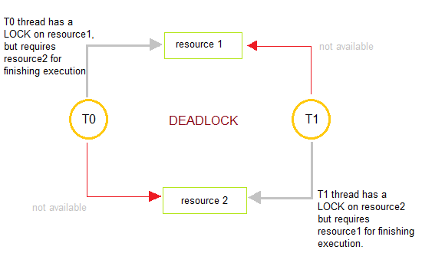
DeadLock
+In this figure, process T0 has resource1, it requires resource2 in order to finish its execution. Similarly, process T1 has resource2 and it also needs to acquire resource1 to finish its execution. In this way, T0 and T1 are in a deadlock because each of them needs the resource of others to complete their execution but neither of them is willing to give up their resources.

Slide 4

Deadlock
In General, a process must request a resource before using it and it must release the resource after using it. And any process can request as many resources as it requires in order to complete its designated task.
And there is a condition that the number of resources requested may not exceed the total number of resources available in the system.

Slide 5
Deadlock
+Basically in the Normal mode of Operation utilization of resources by a process is in the following sequence:
+Request: Firstly, the process requests the resource. In a case, if the request cannot be granted immediately(e.g: resource is being used by any other process), then the requesting process must wait until it can acquire the resource.
+Use: The Process can operate on the resource ( e.g: if the resource is a printer then in that case process can print on the printer).
+Release: The Process releases the resource.

Slide 6
Types of Resources
+ a resource is an object that a process makes use of. A resource can be a piece of hardware such as : tape drive , disk drive ,printer etc.
+or a piece of information such as : a file , a record within a file ,a shared variable ,a critical section etc.
+A computer typically has many different resources. In some cases there may be many instances of a resource of a given type (e.g. buffers), all of which are equivalent. A process needing one of these resources can use any one of them. In other cases there may be only one instance of a resource (e.g. CD-ROM drive with a particular CD).

Slide 7
Types of Resources
+Resources come in two Flavors:
preemptable.
preemptable and Non
+A preemptable resource is one which can be allocated to a given process for a period of time, then be allocated to another process and then be reallocated to the first process without any ill effects. Examples of preemptable resources include memory , buffers
, CPU ,etc.
+A Non preemptable resource cannot be taken from one process and given to another without side effects. One obvious example is a printer: certainly we would not want to take the printer away from one process and give it to another in the middle of a print job

Slide 9
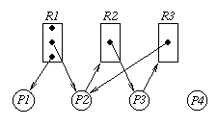
Resource Allocation Graph
+We can use a directed
a resource-allocation
graph
graph
called
to
characterize a deadlock situation.
+Vertices represent resources and processes. We will use rectangular vertices to represent resource classes, with dots within the vertex to represent
instances
vertices
of the resource. Circular
will be used for processes.

Slide 10

Resource Allocation Graph
+A directed edge from a process vertex to a resource vertex indicates that the process has requested an instance
of the resource. This is called
a request edge.
+A directed edge from a dot within a
resource vertex
the resource) to
(an instance of
a process vertex
indicates that the resource has been allocated to the process. This is called a assignment edge.

Slide 11
Resource Allocation Graph
+ in this example the class represented by R1 has three instances of the resource associated with it. P1 and P2 each have allocated an instance of a resource of type R1. P2 has requested an instance of resource type R2, but is waiting since the only instance is held by P3. P3 is in turn requesting a resource of type R3 but the only instance of that type is held by P2. The situation depicted in this graph is deadlocked. P2 is waiting for a resource held by P3, and P3 is waiting for a resource held by P2. This can be shown to be a cycle with
+ P2 -> R2 -> P3 -> R3 -> P2

Slide 12
Conditions for Deadlock
+ The deadlock situation can only arise if all the following four conditions hold simultaneously:
+ 1.Mutual Exclusion
+ According to this condition, at least one resource should be non-shareable (non-shareable resources are those that can be used by one process at a time.)
+ 2. Hold and wait
+ According to this condition, A process is holding at least one resource and is waiting for additional resources.
+ 3. NO pre-emption
+ Resources cannot be taken from the process because resources can be released only voluntarily by the process holding them.
+ 4. Circular wait
+ In this condition, the set of processes are waiting for each other in the circular form.
+ The above four conditions are not completely independent as the circular wait condition implies the hold and wait condition. We emphasize on the fact that all four conditions must hold for a deadlock.

Slide 13
Deadlock Prevention
Deadlock Ignorance
Handling Deadlock
Deadlock Avoidance
Bankers Algorithm
Deadlock Detection
Resource Allocation
Recovery from Deadlock

Slide 14

Deadlock Ignorance
+Pretend that there is no problem, it is the easiest way to deal with the problem.
+The simplest approach is the ostrich algorithm: stick your head in the sand and pretend there is no problem at all.
+Different people react to this strategy in different ways. Mathematicians find it totally unacceptable and say that deadlocks must be prevented at all costs.

Slide 15
Ostrich Algorithm
+This Method is reasonable if :
+Deadlock occur very rarely
+Cost of Prevention is high
+UNIX and Windows take this approach
,just ignore the
problem on the assumption that most users would prefer an occasional deadlock to a rule restricting all users to one process, one open file, and one of everything.
+Deadlocks typically handled by rebooting.

Slide 16
Handling Deadlock
+Deadlock Prevention
+Deadlock happens only when Mutual Exclusion, hold and wait, No pre-emption and circular wait holds simultaneously. If it is possible to violate one of the four conditions at any time then the deadlock can never occur in the system.
+The idea behind the approach is very simple that we have to fail one of the four conditions but there can be a big argument on its physical implementation in the system.

Slide 17

Deadlock prevention
+Denying the mutual exclusion:
+Theoretically,
by denying
deadlock can be
the mutual
prevented
exclusion
precondition. This is usually not possible in
practice, convert
though the use of spooling to serially reusable devices into
seemingly shareable virtual devices could be regarded as an attack at this point. (We could also regard it as a multiplication of the number of printers to the point where each process can have all it needs.)

Slide 18
Deadlock prevention
+Denying the hold and wait precondition
+Deadlock can be prevented by denying the hold and wait
precondition. One approach is as follows:
+1. Require that a process request all the resources that it needs in one single request at process start-up. The system will not grant any resource in the list until it can grant all of them.
+2. A less restrictive approach is to allow a process to request resources only when it is currently holding no resources. Thus, if a process needs a new resource, it must first yield all the resources it has and then put in its request (which might include a request for the reallocation of a resource it just gave up.)

Slide 19
Deadlock Prevention
+Problems with this approach:
+It can lead to processes holding resources when they don't need them, thus reducing resource utilization. This is especially serious if a process does not know what resources it will actually need for a given run until it has started working on the data. With this scheme, it must request up front all the resources it might need.
+A process that needs several popular resources might starve while processes that need a smaller number of these resources keep taking them away.

Slide 20
Deadlock Prevention
+ Denying the no pre-emption precondition
+ Deadlock can be prevented by denying the no pre-emption precondition.
+ Deadlock arises due to the fact that a process can't be stopped once it starts.
However, if we take the resource away from the process which is causing deadlock then we can prevent deadlock.
+ This is not a good approach at all since if we take a resource away which is being used by the process then all the work which it has done till now can become inconsistent.
+ Example: A process holds a tape drive and requests a line printer. If a line printer is not available, the tape drive is taken away and the process is put into a state of waiting for both a tape drive and a line printer.

Slide 21
Deadlock Prevention
+This scheme also has problems:
+It only works if the resources are preemptible. If a process has printed output on a line printer and is waiting for some other resource before it can generate more output, then the line printer really cannot be taken away without messing up the output. (This assumes the approach used by the the system is not practical, as it often is not.)
+This scheme can also lead to starvation for a process that needs several popular resources at the same time, since it may keep losing the resources it gets because they don't all become available at the same time.

Slide 22
Deadlock Prevention
+Making circular wait impossible
+The Fourth necessary condition to cause deadlock is circular wait, In order to ensure violate this condition we can do the following:
+Assign a priority number to each resource. There will be a condition that any process cannot request for a lesser priority resource. This method ensures that not a single process can request a resource that is being utilized by any other process and due to which no cycle will be formed.
+Example: Assume that R5 resource is allocated to P1, if next time P1 asks for R4, R3 that are lesser than R5; then such request will not be granted. Only the request for resources that are more than R5 will be granted.

Slide 23
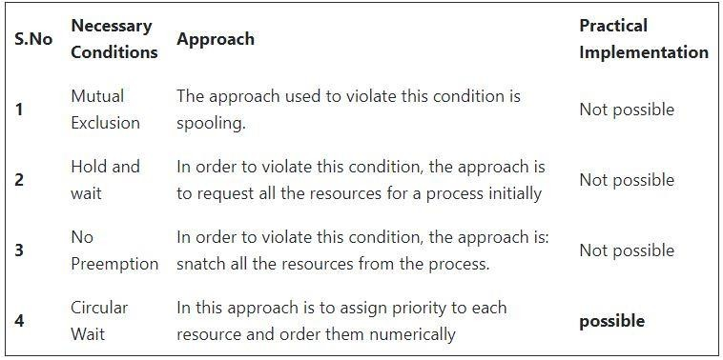
Deadlock Prevention

Slide 24
Deadlock Avoidance in Operating System
+In this method, the request for any resource will be granted only if the resulting state of the system doesn't cause any deadlock in the system. This method checks every step performed by the operating system. Any process continues its execution until the system is in a safe state. Once the system enters into an unsafe state, the operating system has to take a step back.
+According to the simplest and useful approach, any process should declare the maximum number of resources of each type it will need. The algorithms of deadlock avoidance mainly examine the resource allocations so that there can never be an occurrence of circular wait conditions.
+Deadlock avoidance can mainly be done with the help of Banker's Algorithm.

Slide 25
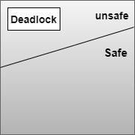
Safe State and Unsafe State
+ Let us first understand the concept of Safe and Unsafe states
+ A state is safe if the system can allocate resources to each process( up to its maximum requirement) in some order and still avoid a deadlock. Formally, a system is in a safe state only, if there exists a safe sequence.
+ So a safe state is not a deadlocked state and conversely a deadlocked state is an unsafe state.
+ Unsafe state cannot allocate resources to the
process.

Slide 26
Bankers Algorithm
+Banker's algorithm is a deadlock avoidance algorithm. It is named so because this algorithm is used in banking systems to determine whether a loan can be granted or not.
+Consider there are n account holders in a bank and the sum of the money in all of their accounts is S. Every time a loan has to be granted by the bank, it subtracts the loan amount from the total money the bank has. Then it checks if that difference is greater than S. It is done because, only then, the bank would have enough money even if all the n account holders draw all their money at once.
+Banker's algorithm works in a similar way in computers.

Slide 27
Characteristics of Banker's Algorithm
+If any process requests for a resource, then it has to wait.
+This algorithm consists of advanced features for maximum resource allocation.
+There are limited resources in the system we have.
+In this algorithm, if any process gets all the needed resources, then it is that it should return the resources in a restricted period.
+Various resources are maintained in this algorithm that can fulfill the needs of at least one client.

Slide 28
Data Structures used to implement the
Banker’s Algorithm
+Let us assume that there are n processes and m resource types.
+Available :It is an array of length m. It represents the number of available resources of each type. If Available[j] = k, then there are k instances available, of resource type Rj.
+Max:It is an n x m matrix which represents the maximum number of instances of each resource that a process can request.
+Allocation: It is an n x m matrix which represents the number of resources of each type currently allocated to each process.
+Need:It is a two-dimensional array. It is an n x m matrix which indicates the remaining resource needs of each process.

Slide 29

+Bankers Resource Request
+Bankers Safety Algorithm
Bankers Algorithm

Slide 30

Disadvantages of Banker's Algorithm
+ Some disadvantages of this algorithm are as follows:
+ During the time of Processing, this algorithm does not permit a process to change its maximum need.
+ Another disadvantage of this algorithm is that all the processes must know in advance about the maximum resource needs.
+ This algorithm permits the requests to be provided in constrained time, but for one year which is a fixed period.

Slide 31
Deadlock Detection and Recovery
+ Deadlock Detection is an important task of OS. As the OS doesn’t take many precautionary means to avoid it. The OS periodically checks if there is any existing deadlock in the system and take measures to remove the deadlocks.
+An algorithm is used to examines the state of the system in order to determine whether a deadlock has occurred.
+An algorithm that is used to recover from the deadlock.

Slide 32
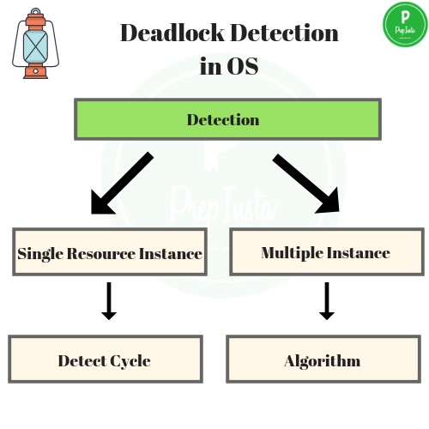
Deadlock Detection and Recovery
+Detection
+If resource has single Instance
+We make a Wait- For graph.
+If resources have multiple
instances
+We make a different algorithm.

Slide 33

Deadlock Detection
+Single instance deadlock detection:
+If all resources have only a single instance, then we can define a deadlock detection algorithm that uses a variant of the resource
–allocation graph, called wait-for graph.
+We obtain this graph from the resource- allocation graph by removing the resource nodes and collapsing the appropriate edges.
+An edge from p_{i} to p_{j} in a wait-for graph implies that process p_{i} is waiting for process p_{j} to release a resource that p_{i} needs.

Slide 34
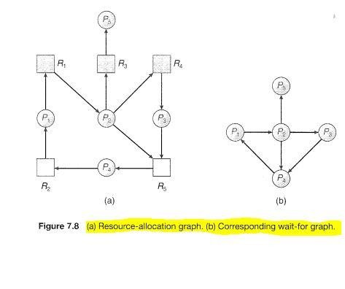
Deadlock Detection
+ An edge p_{i} -> p_{j} exist in wait –for graph if and only if the corresponding resource –allocation graph contains two edges P_{i}-> R_{ij} and R_{q}-> p_{i} for some resource
+ The first figure contains Resource allocation graph and second figure contains Wait-for graph.
+ A deadlock exists in the system if and only of the wait- for graphcontains a cycle.
+ To detect deadlock , the system needs to maintain the wait-for graph and periodically invoke an algorithm that searches for a cycle in the graph.
+ An algorithm to detect a cycle in a graph requires an order of n² operations, where n is the number of vertices in the graph.

Slide 35
Deadlock Detection
+ If there are multiple instances of resources
+ By multiple instance we mean one resource may allow 2 or more accesses concurrently, in such cases –
+ Wait for graph is not applicable.
+ In this, a new algorithm is used. It’s a bit similar to Banker’s Algorithm, but Bankers Algorithm is different.
+ It too uses 3 data structures –
+ Available: Vector of length m , Indicates number of available resources of each type.
+ Allocation :Matrix of size n*m , A[i,j] indicates the number of j th resource type allocated to i th process.
+ Request :Matrix of size n*m , Indicates request of each process.
+ Request[i,j] tells number of instance Pi process is request of jth resource type.

Slide 36
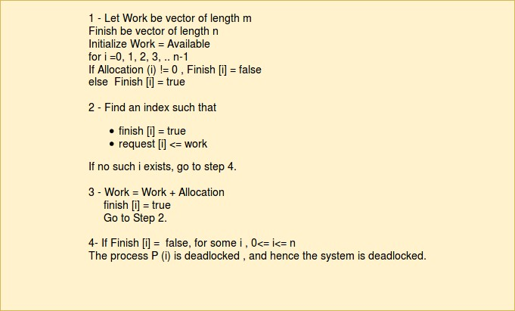
Deadlock Detection

Slide 37
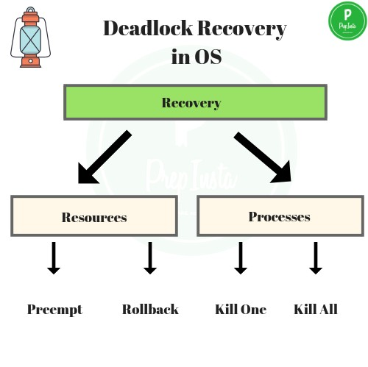
Deadlock Recovery

Slide 38
Kill the Process – One way is to kill all the process in deadlock or the second way kill the process one by one, and check after each if still deadlock exists and do the same till the deadlock is removed.
Pre-emption – The resources that are allocated to the processes involved in deadlock are taken away(pre-empted) and are transferred to other processes. In this way, system may recover from deadlock as we may change system state.
Deadlock Recovery
Rollback – The OS maintains a database of all different states of system, a state when the system is not in deadlock is called safe state. A rollback to previous ‘n’ number of safe states in iterations can help in the recover.

Slide 39
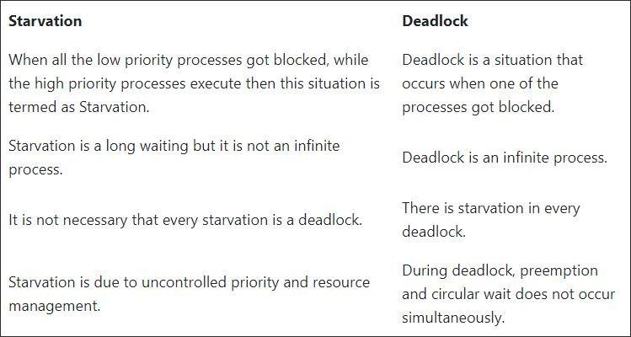
Last but not the least

Slide 40
Thank You

